Slide 1
Lab 6: Process Management

Slide 2
What is a process?
A process is an instance of a computer program being executed using code and instructions
Each process uses system resources like CPU or RAM to complete the specific tasks

Slide 3
Backgrounrd & Foreground Processes
A foreground process is any process which is not continuously running and it waiting on something like user input
A background process is something that is continually running and does not require any additional input
Can someone name examples of each?

Slide 4
Moving a Process to the Background
When executing commands on the command line, there is usually some output that is displayed on the terminal
If you move a process to the background, the output will not be shown

Slide 5
Background Process Example
Usually, when you download a file from the command line, the status is displayed on the terminal
To move a process to the background all you have to do is add an ampersand (&) at the end of the command
Wget http://releases.ubuntu.com/18.04.2/ubuntu-18.04.2-desktop-amd64.iso_ga=2.142658160.410030815.1551071806-1676866732.1550780350 &
Now this will be moved to the background

Slide 6
Moving back to the Foreground
To move a process back to the foreground, use the following steps:
Use the jobs command to identify the job number of the background process
Then use the fg command to bring it back with the following syntax
fg [job number]

Slide 7
How do Processes Actually Work?
In the Unix operating environment, processes are created by a method called “forking”
Forking is when the OS duplicated a process
The original process is called the parent process
And the new process is the child process

Slide 8
Different Types of Processes
There are four types of processes:
  Running: current process that is being executed in the operating system
  Waiting: process which is waiting for system resources to run
  Stopped: process that is not running
  Zombie: process whose parent processes has ended, but the child process is still in the process table

Slide 9
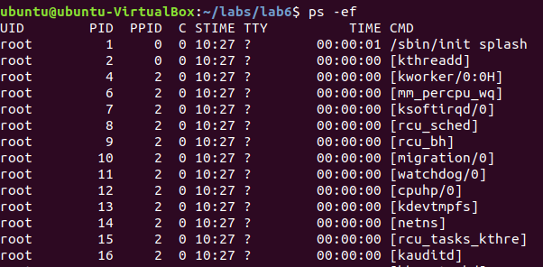
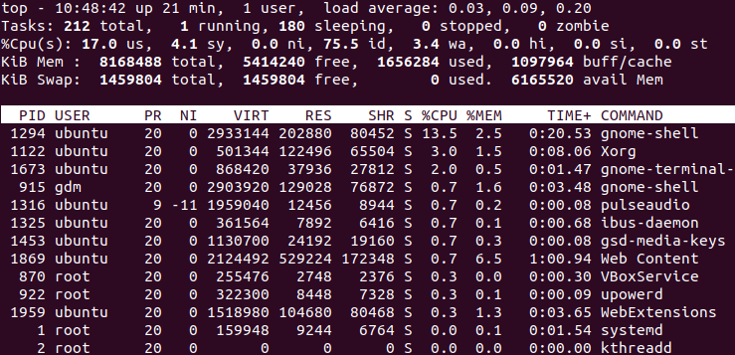
Viewing Processes
Two commands you can use to view the process from the command line: ps and top
To view all the processes with ps, use ps -ef
ps -ef
top

Slide 10
Ending a Process In Linux
Sometimes you need to end a program or process from the command line. Use the following steps:
  Locate the process id [PID] of the process/program you want to kill
  Use the kill command with the following syntax: kill [PID]
  If the process is still running, do the following: kill -9 [PID]
  The -9 is a SIGKILL signal telling the process to terminate immediately

Slide 11
Ending All Process
You can use the killall command to kill multiple processes at the same time
Syntax: killall [options] PIDs
Or you can use pkill –u [username] to kill all processes started by [username]

Slide 12
Forkbombing Example
What is forkbombing? It is when you spawn multiple processes which leads to lack of system resources and other very bad things
I will forkbomb the CCIS server to demonstrate the pkill command
DO NOT TRY THIS (the Systems department will not be happy with you)

